Slide 1

eyewitness memory is reliable, but the criminal justice system is not
John T. Wixted
UC San Diego
UCSD Geisel Library

Slide 2
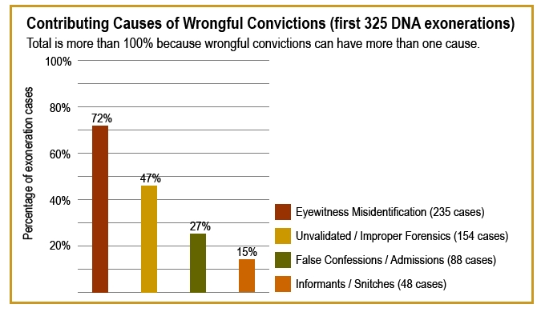
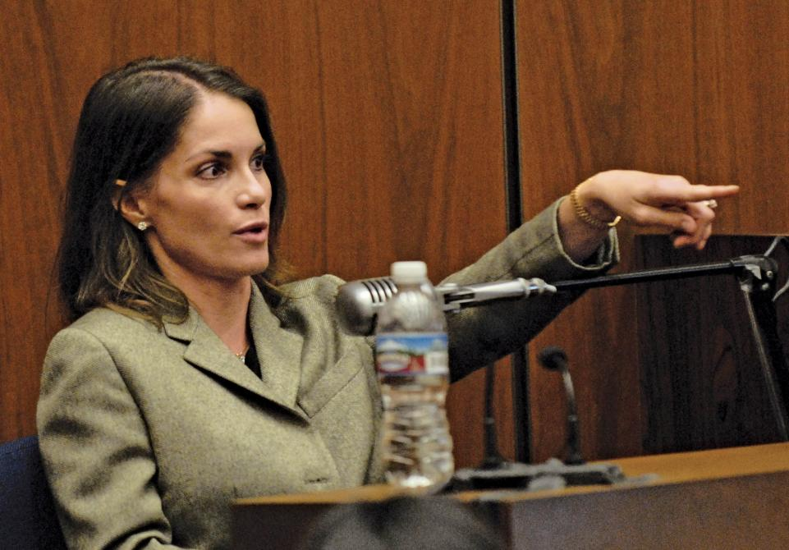
Eyewitness Identification and
Wrongful Convictions
Since the 1990s, the Innocence Project has used DNA testing to overturn 375 wrongful convictions of the innocent
Many spent decades in prison before finally being exonerated
What went wrong?

Slide 3
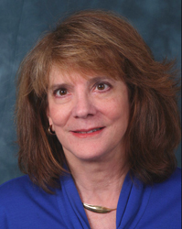
Elizabeth Loftus
University of California, Irvine
In years gone by, the assumption was that memory stores an accurate record of past experience that could be replayed like a videotape
Beginning in the 1970s, work by Loftus and her colleagues instead showed that false memories can be created more easily than previously believed (contaminated forensic memory evidence)

Slide 4
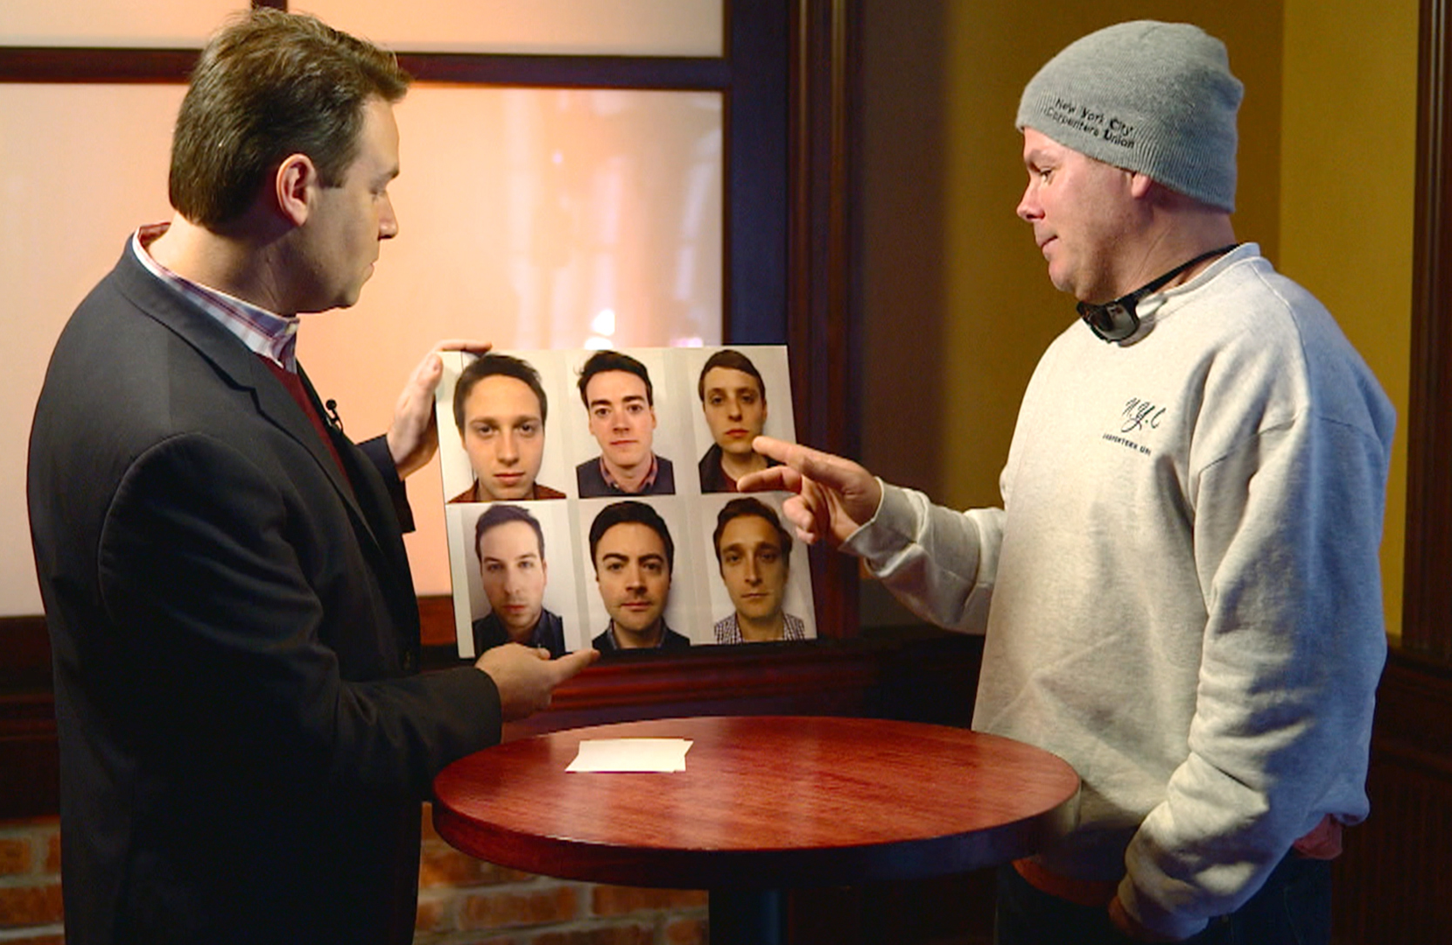
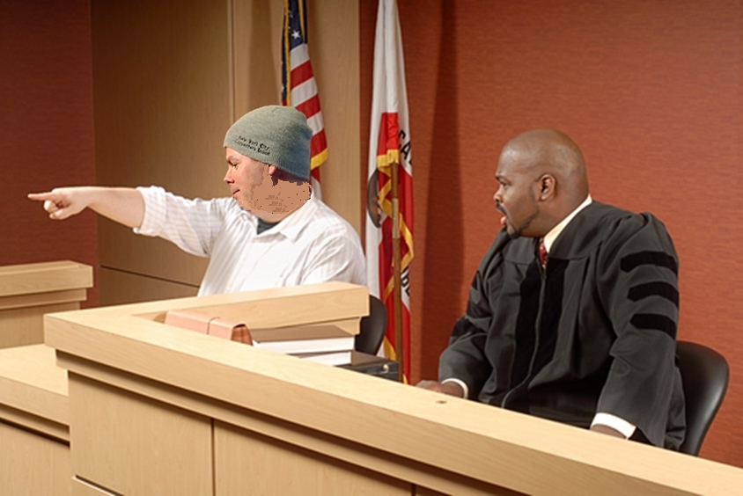
First and Last Eyewitness Identification Tests
Early in a police investigation
Months later at trial

Slide 5

Forensic Pattern Matching
A from the crime scene is compared to a reference sample from the suspect forensic sample (do they match?)
Examples:
  Forensic DNA
  Fingerprints
  Eyewitness identification
Two issues can compromise the reliability of any kind of forensic pattern-matching evidence:
  Has the evidence been contaminated?
  Was the evidence properly tested?

Slide 6
Forensic Pattern Matching
A from the crime scene is compared to a reference sample from the suspect forensic sample (do they match?)
Examples:
  Forensic DNA
  Fingerprints
  Eyewitness identification
The reliability of any kind of forensic pattern-matching evidence will be compromised if it is contaminated

Slide 7
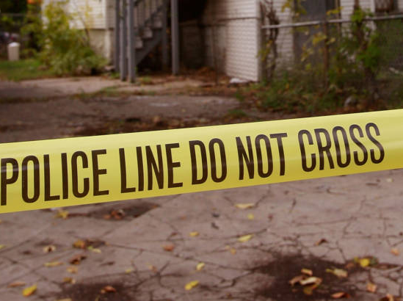
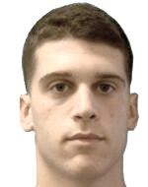
Contaminated forensic evidence
Crime is committed, suspect detained
Evidence collected from crime scene
Match to suspect?

Slide 8


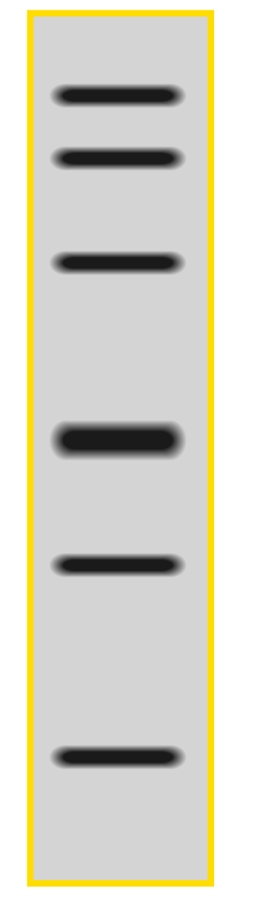
Contaminated forensic evidence
Crime is committed, suspect detained
Evidence collected from crime scene
Match to suspect?
Months later
Trial
Forensic sample
Reference sample

Slide 9
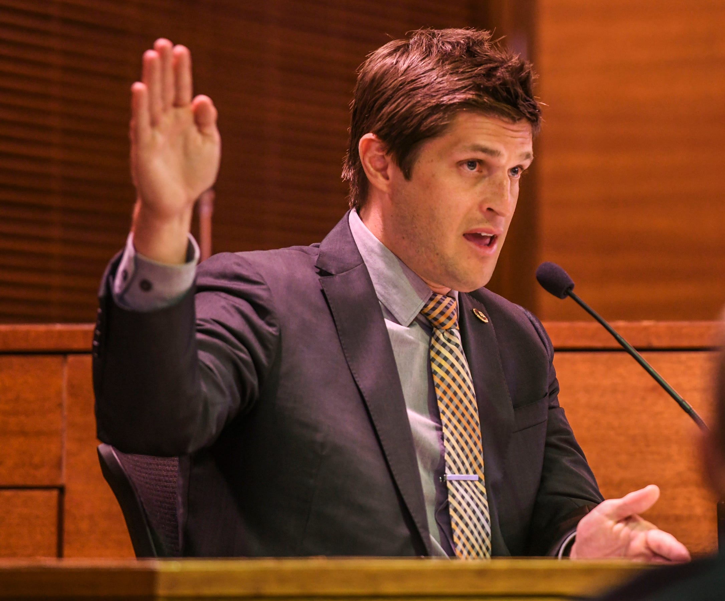
Contaminated forensic evidence
Crime is committed, suspect detained
Evidence collected from crime scene
Match to suspect?
Months later
Trial
Forensic sample
Reference sample

Slide 10
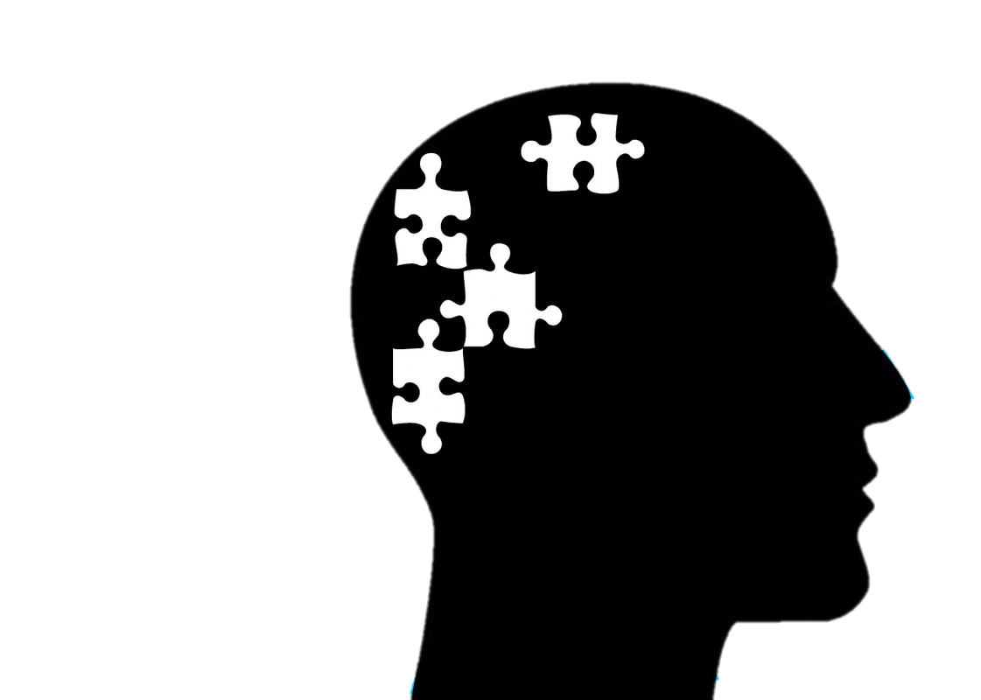
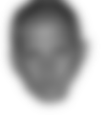
Contaminated forensic evidence
Crime is committed, suspect detained
Evidence collected from crime scene
Match to suspect?
Months later
Trial
Forensic sample
Reference sample

Slide 11
Contaminated forensic evidence
Crime is committed, suspect detained
Evidence collected from crime scene
Match to suspect?
?
Forensic sample
Reference sample

Slide 12


Contaminated forensic evidence
Crime is committed, suspect detained
Evidence collected from crime scene
Match to suspect?
Months later
Trial
Forensic sample
Reference sample

Slide 13
Contaminated forensic evidence
Crime is committed, suspect detained
Evidence collected from crime scene
Match to suspect?
Months later
Trial
The first test unintentionally ― but unavoidably and irretrievably ― changes the witness’s memory for the suspect.

Slide 14
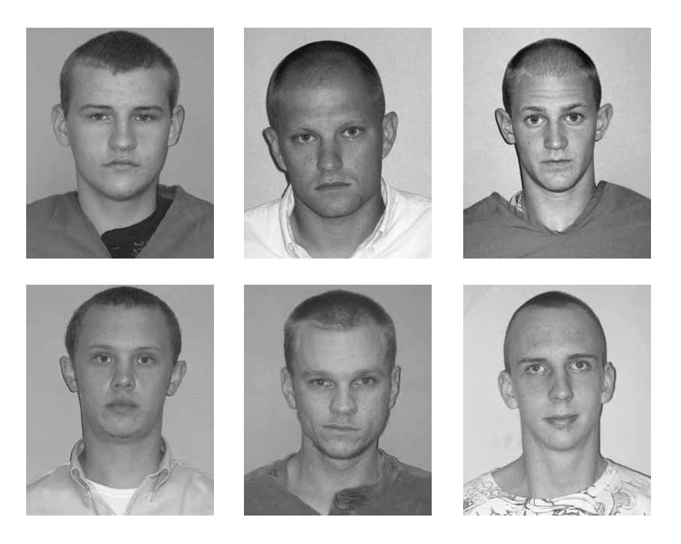

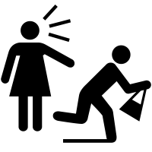
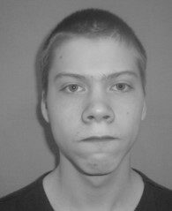
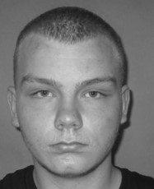
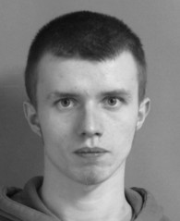
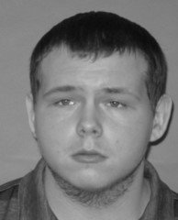
Charman & Cahill (2012)
Mock-crime video
Recognition test #1
Recognition test #2

Slide 15
Contaminated forensic evidence
Crime is committed, suspect detained
Evidence collected from crime scene
Match to suspect?
Months later
Trial
The unavoidable contaminating effect of the first test is why no later test provides more reliable information than the first (no excuses!)

Slide 16
Justifying a second test with an excuse does not decontaminate memory
Witnesses:
  Defense attorney: “You say that you are 100% certain the defendant committed the crime. However, it says right here in the police record that on the photo lineup test you said it looks kind of like him, but you weren’t sure. How could that be?”
  Witness: “I was nervous on the first test, but then I calmed down and searched my memory carefully, and when I did, I knew it was him.”
Judges:
  If the first test was improperly administered (e.g., the police officer steered the witness to pick the suspect), it should be excluded
  A later independent test right here and right now in this courtroom, will serve the cause of justice

Slide 17
Justifying a second test with an excuse does not decontaminate memory
Prosecutors:
  A face can be purely perceptually familiar (“where do I know him from?”), yet when you see that face again, you can remember (“That’s my psychology professor from two years ago!”)
  Therefore, someone can fail to realize that a face is perceptually familiar on the first lineup test and then later, on a second test, realize that it is perceptually familiar after all
Judges:
  If the first test was improperly suggestive, it should be excluded
  A later independent and non-suggestive test would serve the cause of justice
The key point:
  If the first test included a recognizable photo of the suspect, every subsequent test is a test of contaminated forensic memory evidence

Slide 18
Contaminated forensic evidence
Crime is committed, suspect detained
Evidence collected from crime scene
Match to suspect?
Months later
Trial
Bonus: If a proper lineup test is used, the initial test provides reliable information!

Slide 19

Gary Wells
Iowa State University
In years gone by, police lineups were not so much tests of memory as they were methods of inducing witnesses to incriminate suspects (e.g., the suspect stood out, the witness was asked to take another look at the lineup if the suspect was not identified, etc.)
Decades of research has identified how to conduct a proper test of eyewitness memory, devoid of social influence (Wells et al., 2020, Law and Human Behavior)

Slide 20
The Photo Array
Suspect
Only one suspect
At least five fillers
Everyone in the lineup should match the description of the perpetrator provided by the eyewitness
The lineup administrator should be blind to the identity of the suspect

Slide 21
When a photo lineup becomes a test of memory per se…
All of a sudden, the principles of recognition memory that have been worked out in basic science laboratories over the decades become relevant
In particular, the theoretical framework that has effectively guided thinking about memory signals in the brain for more than half a century―signal detection theory―can guide our thinking about eyewitness identification
Basic research on recognition memory often involves testing memory for lists of words, which, on the surface, seems very far removed from eyewitness memory

Slide 22
STUDY LIST
honey
candy
dinner
present
sword
belief
shore
kitchen
cradle
snake

Slide 23
RECOGNITION TEST
drama
belief
folly
sword
thorn
kitchen
candy
message
drink
snake
ground
dinner
cradle
honey
doctor
present
woods
shore
journal
sister

Slide 24
RECOGNITION TEST
drama
belief
folly
sword
thorn
kitchen
candy
message
drink
snake
ground
dinner
cradle
honey
doctor
present
woods
shore
journal
sister
“Guilty” targets
“Innocent” foils

Slide 25
RECOGNITION TEST
drama
belief
folly
sword
thorn
kitchen
candy
message
drink
snake
ground
dinner
cradle
honey
doctor
present
woods
shore
journal
sister

Slide 26
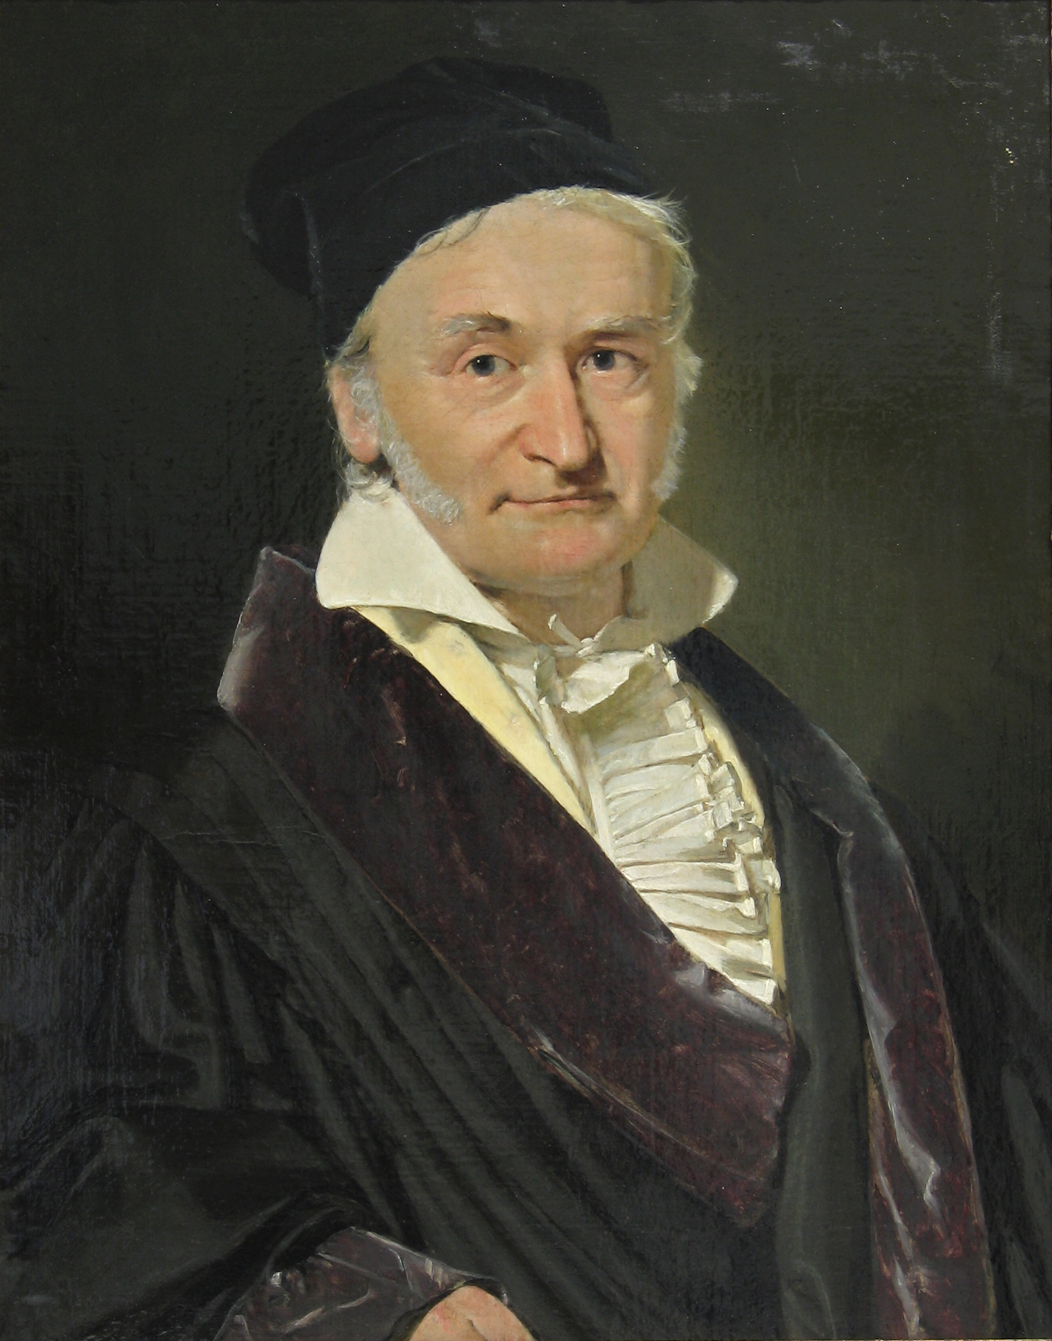
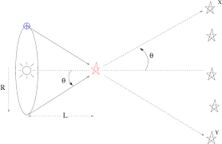
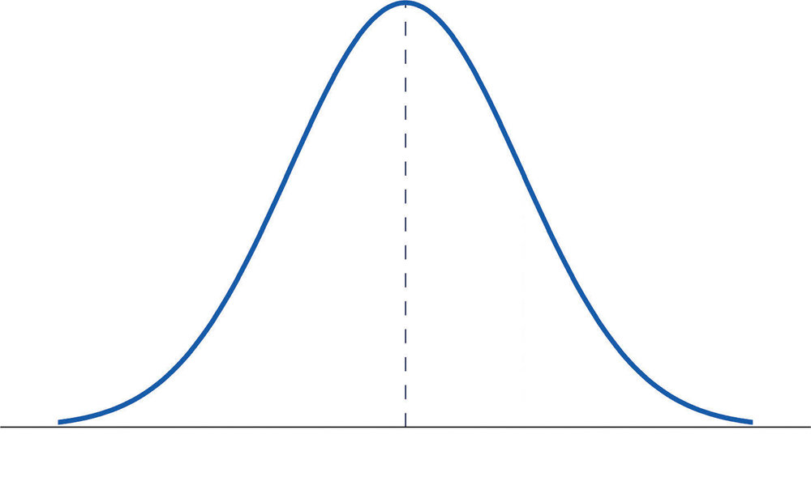
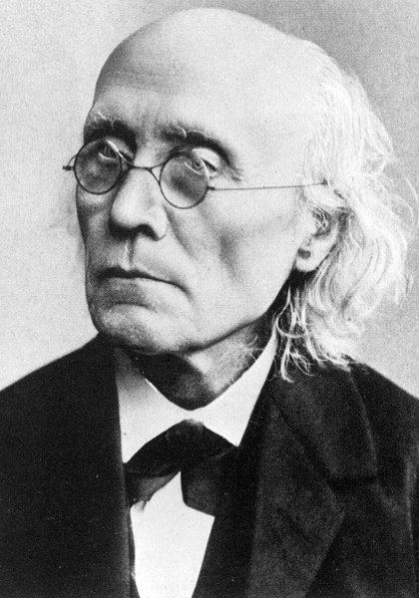
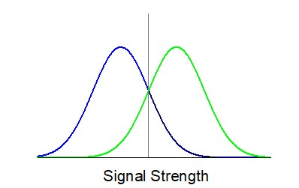
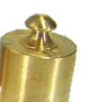
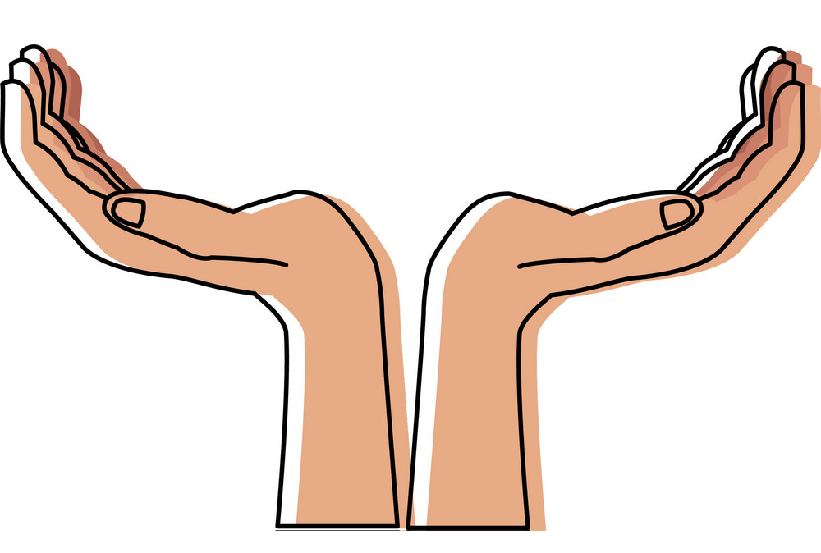

Gauss (1809)
Light
Internal Sensation
Heavy
Fechner (1860)

Slide 27
The Education of Yours Truly
Although I didn’t realize it at the time, I was in basic training for the first 20 years of my academic career
For 20 years, I tested competing signal detection models of recognition memory to figure out which one was correct
Everything I know about eyewitness memory I learned by testing a homogenous group of intelligent undergraduates for their ability to recognize a word that may or may not have been presented on a recent list

Slide 28
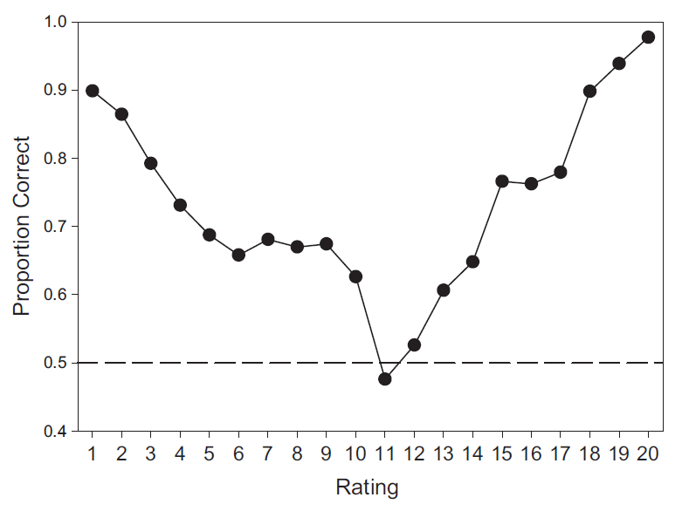
Signal Detection Theory
Mickes, Hwe, Wais, & Wixted (2011)
Weak memory
Strong memory
Notes:
When it comes to understanding recognition memory (and analyzing empirical data), signal detection theory protects from the dangerous predictions you will otherwise almost certainly have

Slide 29
The eyewitness confidence-accuracy in the lab
Wixted, J. T. & Wells, G. L. (2017). The relationship between eyewitness confidence and identification accuracy: A new synthesis. Psychological Science in the Public Interest, 18, 10-65.
This relationship is the virtual definition of eyewitness reliability
Notes:
This is an intuitive approach, one that makes sense to most people, and that’s the problem. This is not how one would analyze the data if guided by signal detection theory.

Slide 30
Houston Police Department Field Study
Wixted, Mickes, Dunn, Clark & W. Wells (2016, PNAS)
348 eyewitnesses were tested in actual criminal investigations
All received fair, double-blind photo lineups (proper testing)
IDs were made with low, medium or high confidence
Estimated
Notes:
Conducted early in the police investigation, minimizing the chances of contamination, and properly tested ➔ Decisions based on memory-match signal. Results just as predicted by SDT and just as predicted by corresponding lab data. The only other possibility is that memory was secretly contaminated in dozens of investigations despite no evidence and in just such a way as to make the data come out as predicted. That is an “anything is possible” attitude. The burden of proof has to be on those who adopt that attitude.

Slide 31
The very act of testing memory with a lineup contaminates the witness’s memory
Elaborative processing is (1) how to make memories and (2) is precisely what the witness does when making a decision about a face in the lineup
Winograd, E. (1981). Elaboration and distinctiveness in memory for faces. JEP: Human Learning and Memory, 7(3), 181–190.

Slide 32
The very act of testing memory with a lineup contaminates the witness’s memory

Slide 33
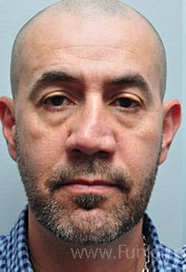
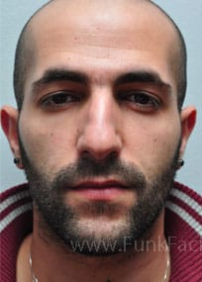
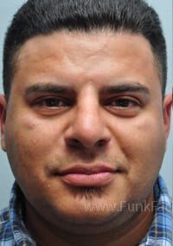
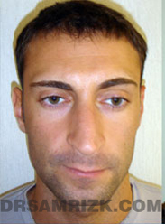
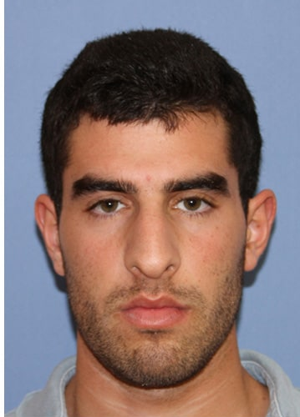
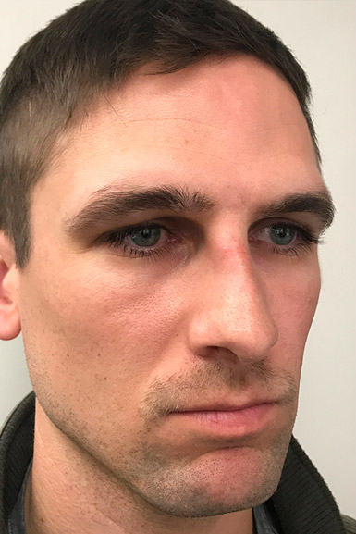
Elaborative face processing
Nondistinctive (shared) features

Slide 34
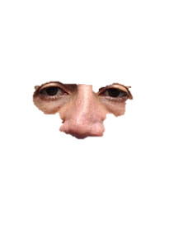
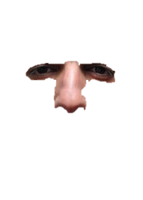
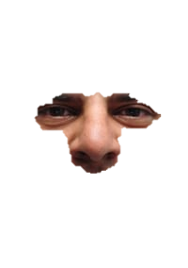
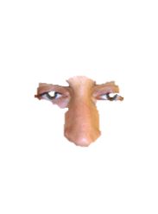
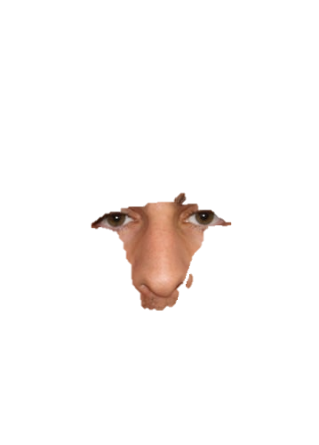
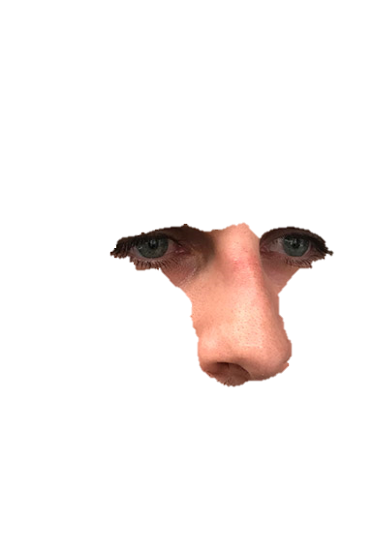
Elaborative face processing
Nondistinctive (shared) features
Notes:
(1) What you attend to you, you form a memory representation of; (2) the closer the face representations are in multidimensional space, the more similar they are perceived to be

Slide 35
Elaborative face processing

Slide 36
Elaborative face processing

Slide 37
Elaborative face processing

Slide 38
Elaborative face processing

Slide 39
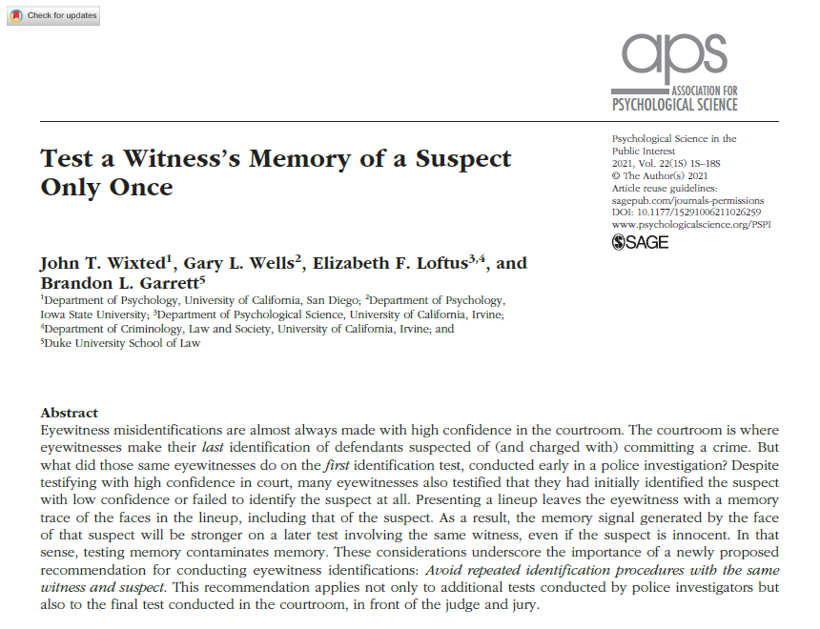

Slide 40
Justifying a second test with an excuse does not decontaminate memory
Witnesses:
  Defense attorney: “You say that you are 100% certain the defendant committed the crime. However, it says right here in the police record that on the photo lineup test you said it looks kind of like him, but you weren’t sure. How could that be?”
  Witness: “I was nervous on the first test, but then I calmed down and searched my memory carefully, and when I did, I knew it was him.”
Judges:
  If the first test was improperly administered (e.g., the police officer steered the witness to pick the suspect), it should be excluded
  A later independent test right here and right now in this courtroom, will serve the cause of justice

Slide 41
(1) Eyewitness identification is reliable on the first test, and (2) testing memory contaminates memory for the suspect
Conclusive suspect ID
Notes:
Two views, two predictions: (1) if eyewitness memory is a train wreck, we should find lots of high-confidence misidentifications not just at trial but also way back at the time of the first ID; (2) if eyewitness memory is instead reliable on the first test, most of the time when we look back we’ll find that the witness basically said “the face of the suspect does not conclusively match my memory of the perpetrator.”

Slide 42
(1) Eyewitness identification is reliable on the first test, and (2) testing memory contaminates memory for the suspect
Inconclusive suspect ID
Conclusive suspect ID
Filler ID innocence
Lineup rejection innocence
Notes:
Two views, two predictions: (1) if eyewitness memory is a train wreck, we should find lots of high-confidence misidentifications not just at trial but also way back at the time of the first ID; (2) if eyewitness memory is instead reliable on the first test, most of the time when we look back we’ll find that the witness basically said “the face of the suspect does not conclusively match my memory of the perpetrator.”

Slide 43
(1) Eyewitness identification is reliable on the first test, and (2) testing memory contaminates memory for the suspect
Inconclusive suspect ID
Conclusive suspect ID
Filler ID innocence
Lineup rejection innocence
Notes:
Two views, two predictions: (1) if eyewitness memory is a train wreck, we should find lots of high-confidence misidentifications not just at trial but also way back at the time of the first ID; (2) if eyewitness memory is instead reliable on the first test, most of the time when we look back we’ll find that the witness basically said “the face of the suspect does not conclusively match my memory of the perpetrator.”

Slide 44
Face Familiarity (vs. Recollection of Details)
Consider seeing a man on a bus whom you are sure that you have seen before; you “know” him in that sense. Such a recognition is usually followed by a search process asking, in effect, Where could I know him from? Who is he? The search process generates likely contexts (Do I know him from work; is he a movie star, a TV commentator, the milkman?). Eventually the search may end with the insight, That’s the butcher from the supermarket!
(Mandler, 1980, pp. 252– 253)

Slide 45
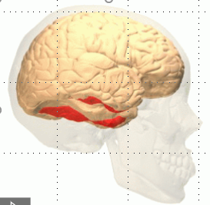
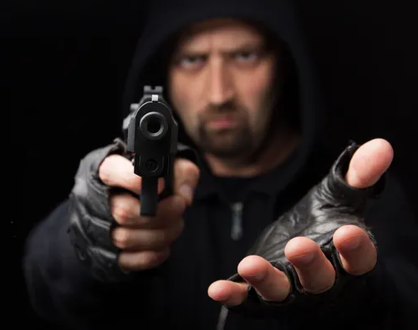
Before the First Test (Encoding)
Brodt & Gais (2021): “…information is stored in the same neural circuits that participate in its initial processing, and also at the same level of conceptual abstraction” (p. 428).

Slide 46
Face Familiarity is not a Search Process!
Brodt & Gais (2021): “…information is stored in the same neural circuits that participate in its initial processing, and also at the same level of conceptual abstraction” (p. 428).

Slide 47
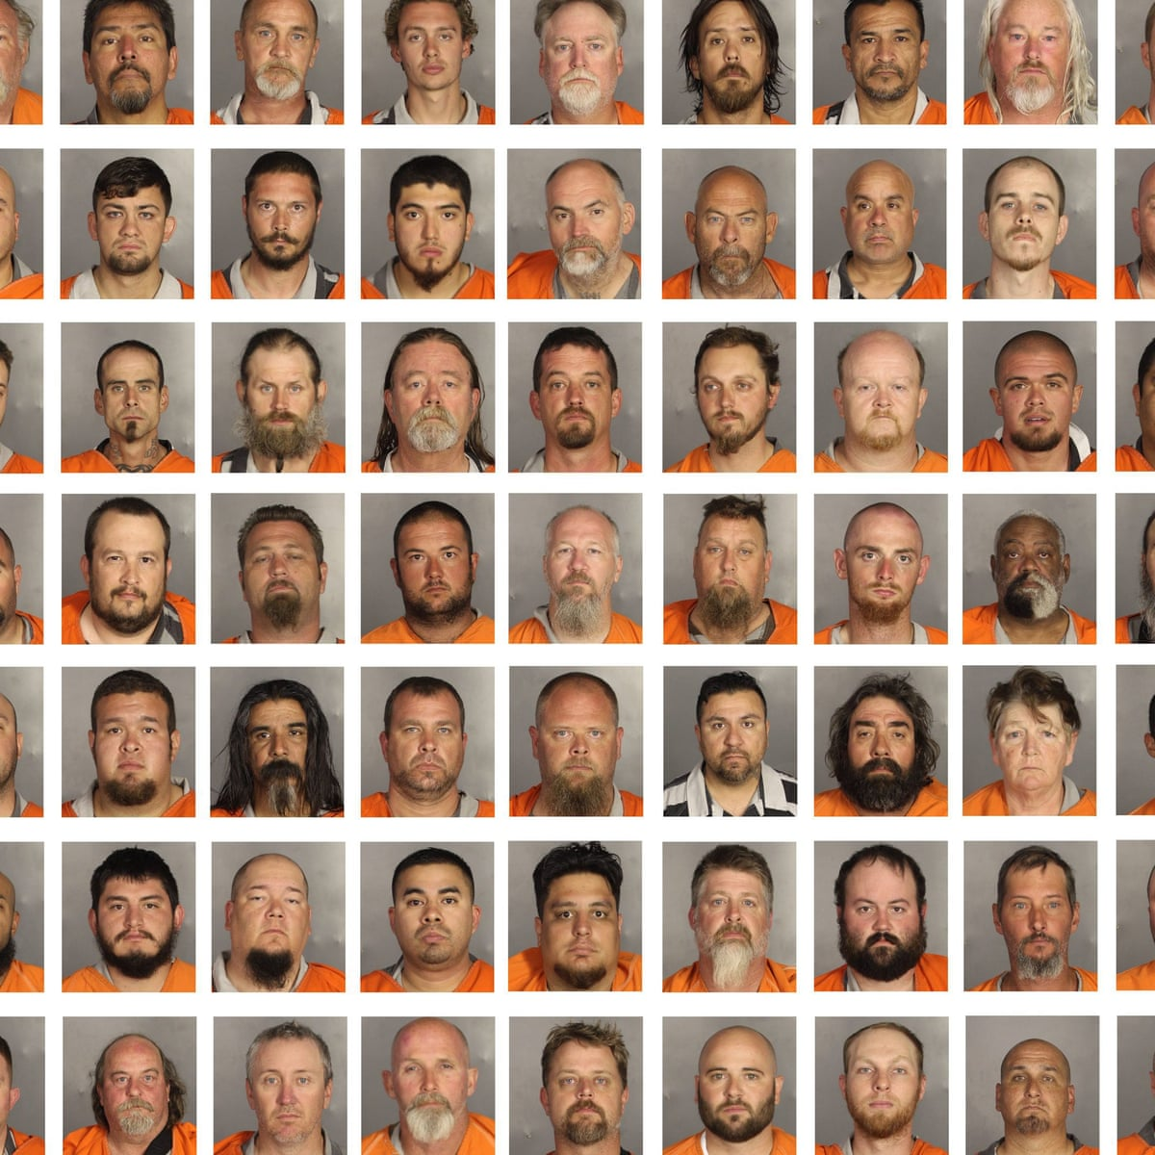
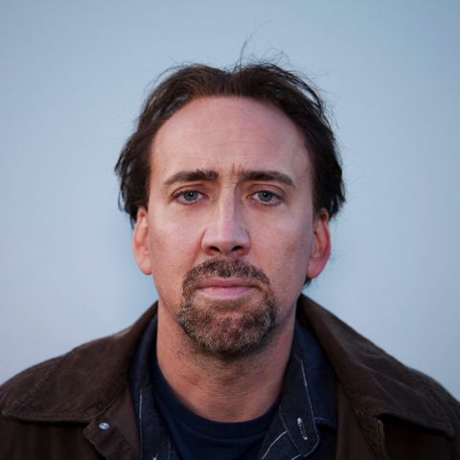
Face Familiarity is not a Search Process!
Brodt & Gais (2021): “…information is stored in the same neural circuits that participate in its initial processing, and also at the same level of conceptual abstraction” (p. 428).

Slide 48
Face Familiarity is not a Search Process!
Brodt & Gais (2021): “…information is stored in the same neural circuits that participate in its initial processing, and also at the same level of conceptual abstraction” (p. 428).

Slide 49
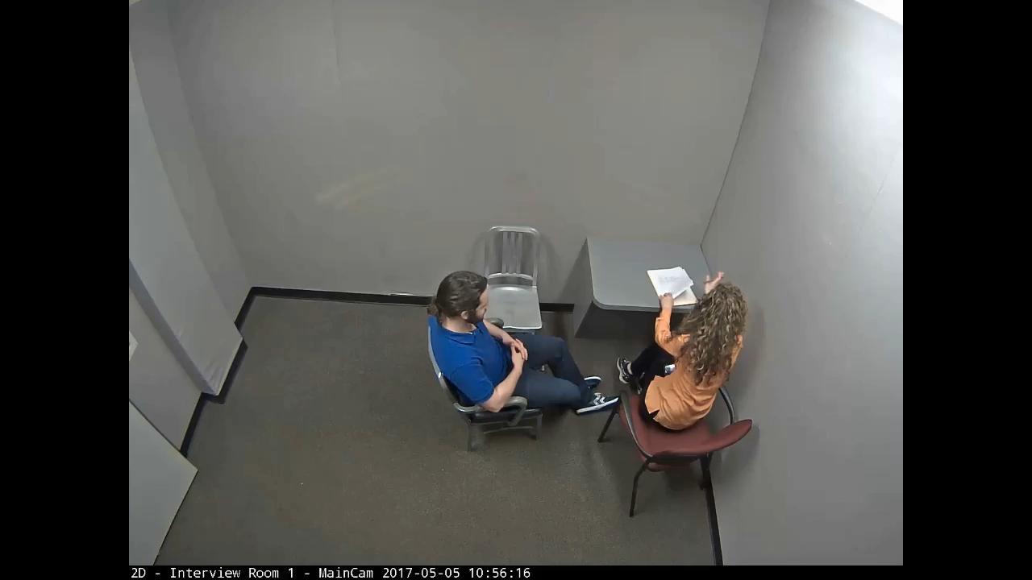

Slide 50
(1) Eyewitness identification is reliable on the first test, and (2) testing memory contaminates memory for the suspect
Inconclusive suspect ID
Conclusive suspect ID
Filler ID innocence
Lineup rejection innocence
Notes:
Two views, two predictions: (1) if eyewitness memory is a train wreck, we should find lots of high-confidence misidentifications not just at trial but also way back at the time of the first ID; (2) if eyewitness memory is instead reliable on the first test, most of the time when we look back we’ll find that the witness basically said “the face of the suspect does not conclusively match my memory of the perpetrator.”

Slide 51
James Joseph Garner
Garner was convicted of shooting at 3 brothers at a bar in 2009. The victims described the perpetrator as being 6’ tall, with tattoos, bald and having no facial hair or glasses; Garner is 5’8”, had no tattoos, was not bald, and did have both facial hair and glasses.
On the first test, all three brothers failed to identify him from a photo lineup (more evidence of innocence), but at trial, they emphatically testified that he was the shooter.
Garner was found guilty and sentenced to 32 years in prison, and all appeals have been exhausted

Slide 52
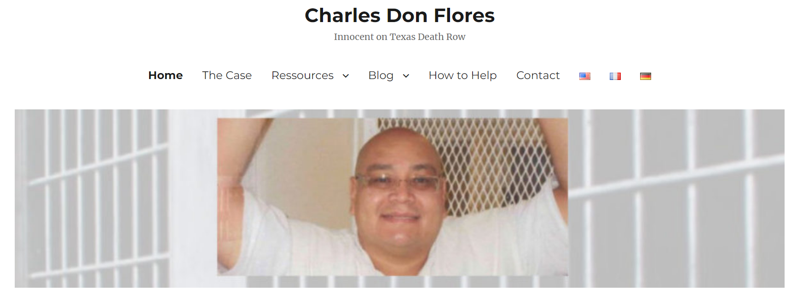

Slide 53

The Murder of Betty Black
On Jan. 29, 1998, witness Jill Bargainer looked through her miniblinds around 6:45 a.m. and saw two men go into her neighbor’s house through the garage.
After learning later in the day that her neighbor had been murdered, she contacted the police and told them that both men were white with shoulder-length hair

Slide 54
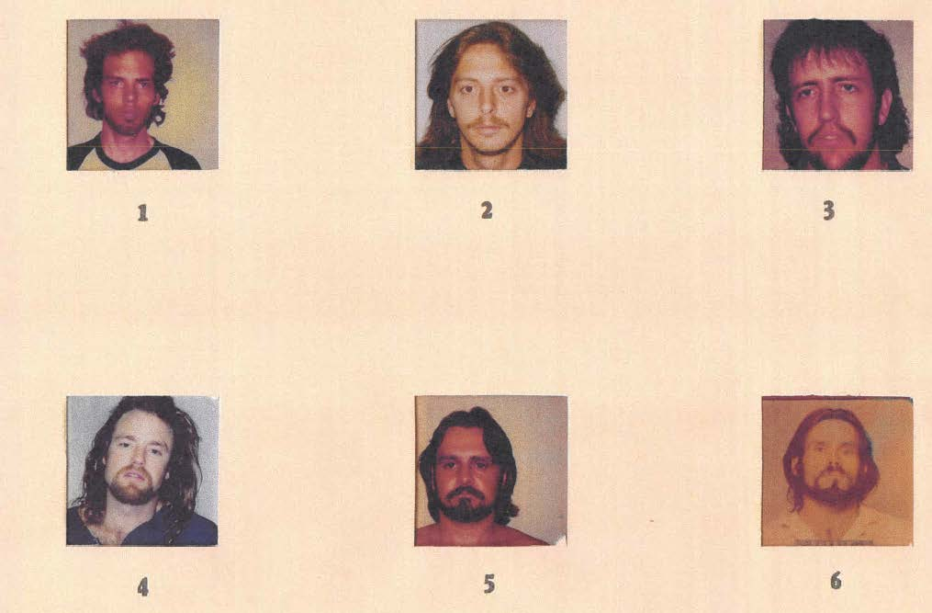
The Murder of Betty Black
The police suspected a man named Richard Lynn Childs and placed his photo in a lineup
Bullets of the same caliber used to murder Mrs. Black were found in his car, and he owned a gun of that same caliber
Childs confessed to murdering Mrs. Black, was sentenced to 35 years in prison, and served 16 years before being released on parole.

Slide 55
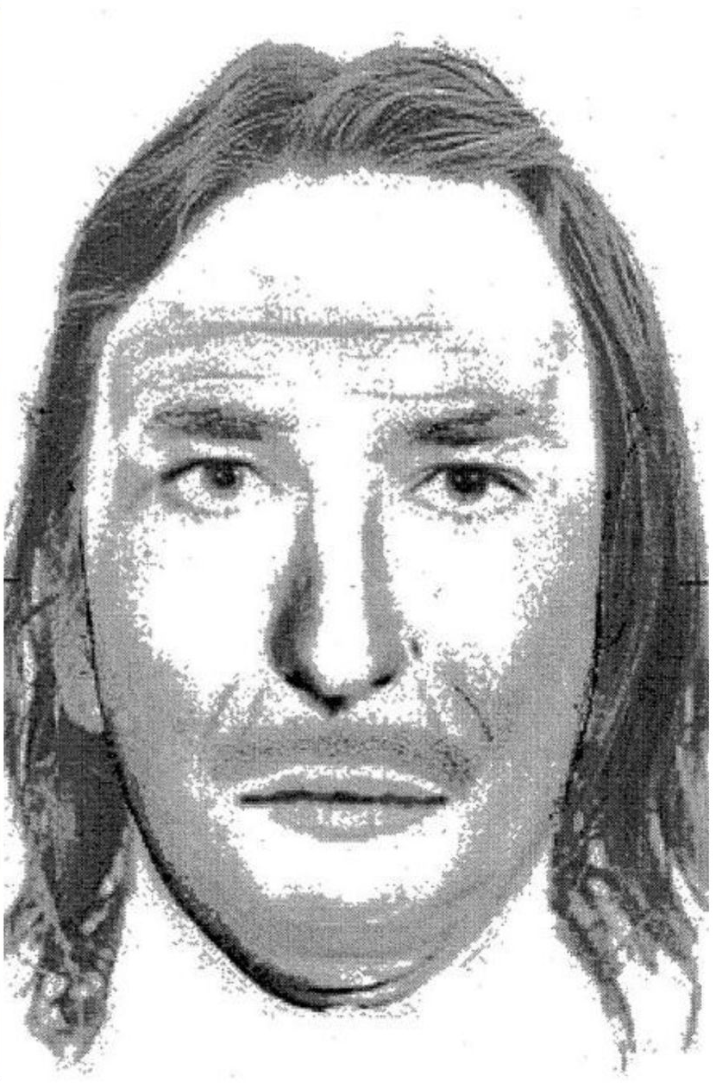
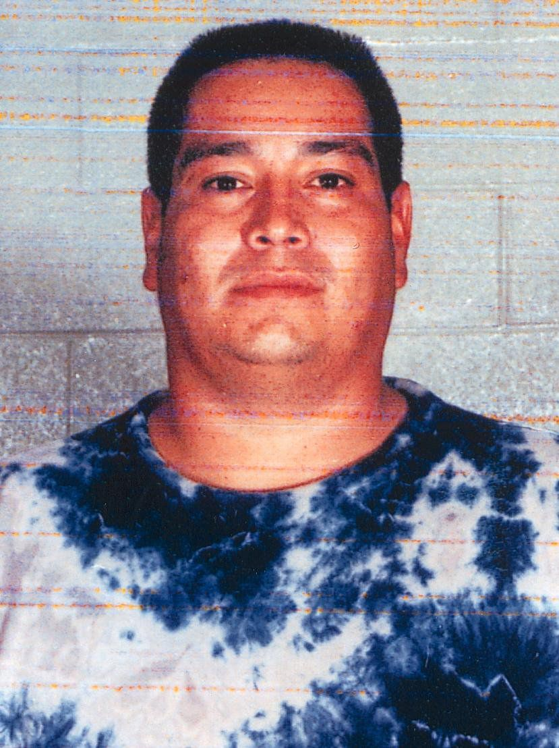
Who was the Accomplice?
The police suspected a man named Charles Don Flores
He was a known associate of Childs, and they had engaged in a drug deal just hours earlier
However, Flores is not a thin white man with long hair, as the witness described; instead, he is a large Hispanic man with short hair
The police put his photo in a lineup anyway and presented it to the witness

Slide 56
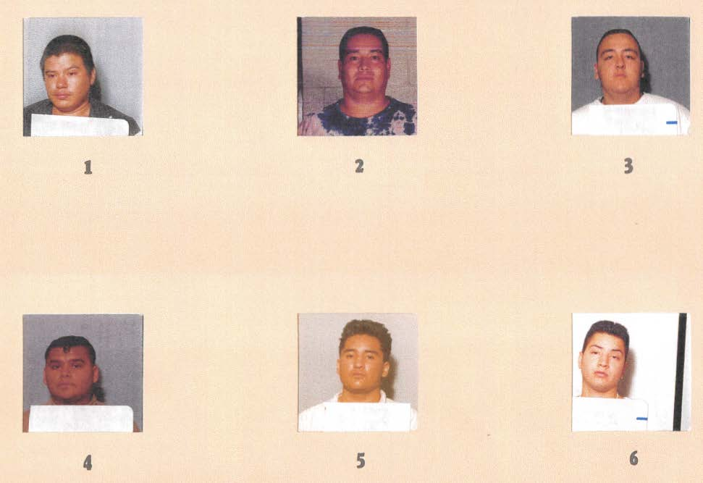
Jill Bargainer rejected this lineup

Slide 57
The Capital Conviction of Charles Don Flores
About 1 year later, at trial in 1999, Jill Bargainer surprised the defense by showing up and identifying Flores as the accomplice, claiming to be “more than 100 percent positive”
The jury convicted Flores and sentenced him to death
He has been on death row for 22 years, he has lost all appeals, and he is now waiting for his execution date to be set.
Yet, on the first and only uncontaminated test, Jill Bargainer provided compelling evidence of innocence, not guilt

Slide 58
The crux of the issue
These cases are not the exception
They are the rule
High-confidence misidentifications happen at trial (almost every time), but they are rare at the time of the first identification

Slide 59
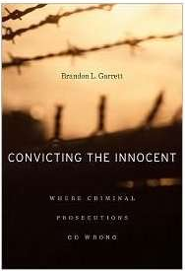
Obtained court testimony for 161 DNA exoneration cases involving eyewitness misidentication. Courtroom IDs were typically made with high confidence
92 of those cases had testimony about the initial ID (the remaining 62 cases did not)
In all 92 cases, the testimony indicated that the eyewitness was initially not certain about his or her identification

Slide 60
A New Perspective
Old message:
  Eyewitness memory is unreliable across the board; a train-wreck, basically
  The courtroom setting is highly suggestive, making an already bad situation even even worse
  Therefore, ignore what eyewitnesses have to say, especially in court
New message:
  Eyewitness memory is highly reliable on the first properly conducted test
  The courtroom provides a test of contaminated forensic memory evidence, and this would be true if even it were not a suggestive test
  Instead of ignoring what eyewitnesses have to say, pay very close attention to what they said on the first test because, on that reliable test, you will often find evidence of innocence

Slide 61
Test a Witness’s Memory for a Suspect Only Once
On the first properly-conducted test of uncontaminated memory, eyewitnesses are highly reliable
But the first test contaminates memory, so no later test provides more reliable information than the first
It is other actors in the criminal justice system, not eyewitnesses, who are to blame for the wrongful convictions ordinarily attributed to “eyewitness misidentification”
The solution is (in principle) so simple: Don’t test a witness’s memory for a suspect more than once

